Slide 1
Fundamentals and Methods of Computer Science
Exercise week 5

Slide 2
Today’s Menu
Project Idea Presentations & What is this Machine Learning?
Discussion of assignment 4 and the respective quiz
Brief summary of skills necessary to solve assignment 5
Working on assignment 5

Slide 3
Project Idea Presentations & What is Machine Learning?

Slide 4
Disclaimer on “Machine Learning” Requirement
Project Work
Your project will be evaluated based on the 8 requirements communicated in class. Number 5 is about Machine Learning. What does this mean? This slide helps you get an intuition on what to expect:
“Machine Learning” is a fancy term for statistical inference from data. This means to draw conclusions about some data point(s) based on (a large number) of existing data points.
The more data we have, the more likely it is that there are patterns in this data (e.g., people with longer legs compared to their torsos might run faster than people with shorter relative leg length).
A machine can identify such patterns (= learning).
Given a new data point (e.g., my personal relative leg length), the machine might draw a conclusion (= inference, e.g., my running pace).
Based on the example, this procedure might seem overwhelming & underwhelming at the same time.

Slide 5
Disclaimer on “Machine Learning” Requirement
Project Work
I haven’t taken statistics yet and am still trying to understand this term.
Your project will be evaluated based on the 8 requirements communicated in class. Number 5 is about Machine Learning. What does this mean? This slide helps you get an intuition on what to expect:
“Machine Learning” is a fancy term for statistical inference from data. This means to draw conclusions about some data point(s) based on (a large number) of existing data points.
The more data we have, the more likely it is that there are patterns in this data (e.g., people with longer legs compared to their torsos might run faster than people with shorter relative leg length).
A machine can identify such patterns (= learning).
Given a new data point (e.g., my personal relative leg length), the machine might draw a conclusion (= inference, e.g., my running pace).
And this simple idea gives companies $bn valuations?
Based on the example, this procedure might seem overwhelming & underwhelming at the same time.

Slide 6








Statistics
Recap (or trailer) of your statistics class
Independent variable(s)
Dependent variable
$$Y$$
$$f$$
$$\hat{f:}$$
$$Y=β_{0}+β_{1}X_{1}$$
Relative Leg Length ($X_{1}$)
f
Relative Weight ($X_{2}$)
Running Speed ($Y$)
Weekly Exercise km ($X_{3}$)
$$X_{1}$$
Using a sample (a few dots ), we try to find the underlying «unknown connection» $f$ between the Independent variable(s) & the Dependent variable for the whole population (all possible dots). In simple linear regression, we approximate $f$ with the «best fitting» line $\hat{f}$ (it does not matter for the explanation, how «best fit» is determined).

Slide 7
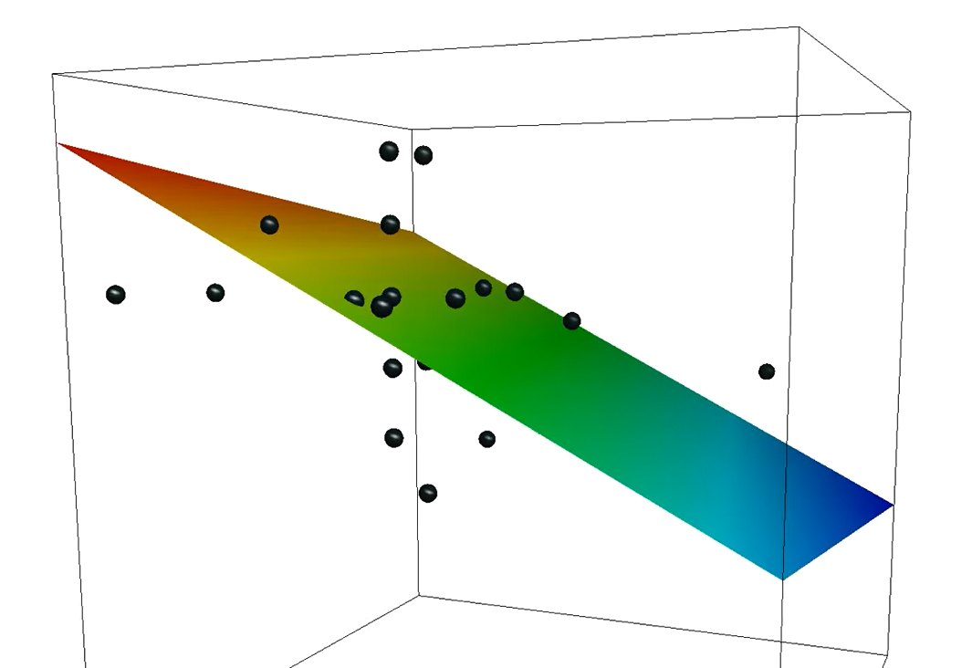





Statistics
Recap (or trailer) of your statistics class
$$X_{1}$$
Independent variable(s)
Dependent variable
Grade
$$f$$
$$X_{2}$$
Relative Leg Length ($X_{1}$)
$$Y$$
f
Relative Weight ($X_{2}$)
Running Speed ($Y$)
Weekly Exercise km ($X_{3}$)
$$\hat{f:} Y=β_{0}+β_{1}X_{1}+β_{2}X_{2}$$
A single independent variable often doesn’t contain enough information to accurately model the dependent variable. Hence, more variables are incorporated (incl. ideas to add non-linearity) to model more complex formulas. (Again, for the explanation it does not matter, how these variables are incorporated).

Slide 8



Statistics
Recap (or trailer) of your statistics class
$$X_{1}$$
Independent variable(s)
Dependent variable
Grade
$$f$$
$$X_{2}$$
$$β= \left(\begin{matrix}β_{0} \\ β_{1} \\ β_{2}\end{matrix}\right)$$
$$X=\left(\begin{matrix}1 \\ X_{1} \\ X_{2}\end{matrix}\right)$$
$$Y$$
f
Running Speed ($Y$)
Weekly Exercise km ($X_{3}$)
$\hat{f:}$ $Y=β^{T}X$
So far, we used only two/three dimensions to illustrate the reasoning graphically. To extend the idea and incorporate even more information, we need a new notation, i.e., $β^{T}X=β_{0}∗1 + β_{1}∗X_{1} + β_{2}∗X_{2}$. (Again, for the explanation the details don’t matter and are only here for completeness).

Slide 9






Why do we need ML?
Machine Learning
The computer can use many, many different input variables (e.g., weight, trainings / week, eye-colour, …) and identifies patterns (=learning) that we might not even have anticipated (maybe red-eyed people run hellishly fast).
This has the advantage, that we don’t need to explicitly model the structure
of the relationship. We only need to give the input and output data to our machine and let it find the patterns ? (=train).
After our model learned the patterns, we can pass a new data point and the machine can infer the ouput for this point.
Input Variables (features)
Output variable
$$X$$
f
$$Y$$
$\hat{f:}$ $Y= ? X$
Instead of defining the relationship between the observed data and the target categories manually (too complex), we want our model to learn this mapping automatically from the data. There will be more details on ML in future lectures, but you need a basic understanding to figure out what data you need for your project.

Slide 10
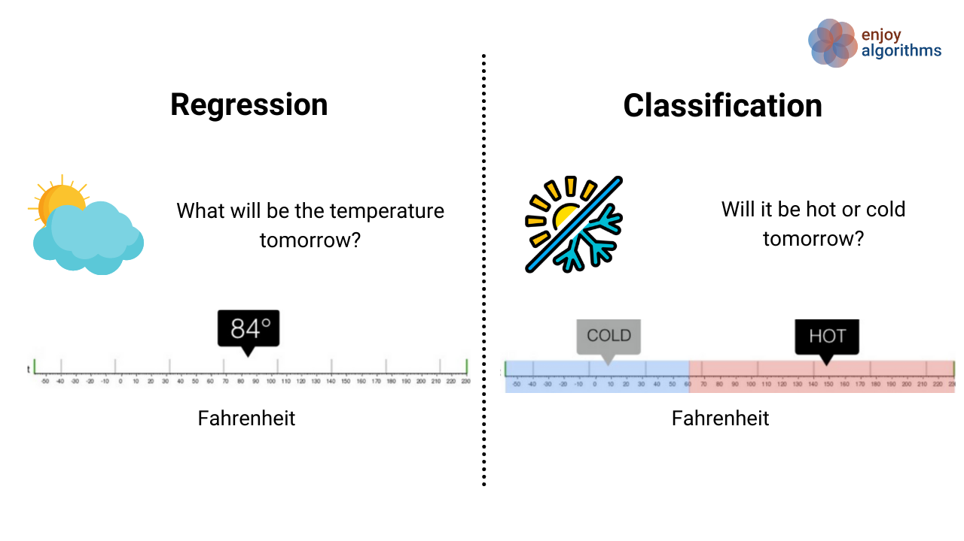


What data do you need?
Image Source: https://www.enjoyalgorithms.com/blogs/ classification-and-regression-in-machine-learning/
Group Project
Regardless of your project, you need Input data for your model.
Input ($X$)
Output (for supervised ML; $Y$)
 | Feature 1 | Feature 2 | …
Observation 1
Observation 2
Observation 3
…
 | Output
Observation 1 | Regression: Number
Observation 2 | Classification: Category e.g. 0,1
Observation 3
…
You need to find data that has a number of features for a number of observations (think about it as a «table»).
This intro explained ML using linear regression, i.e., the idea of supervised ML. For that, you also
need output data for all your observations. Next to «predictions for new data», there are other
things you can do – so keep your idea for future lectures, even if it doesn’t fit this schematics.

Slide 11
How do we implement ML in this course?
Group Project
We will use scikit-learn (a Python library) to instruct the computer to do the learning and to make the inferences for us. What we need to do, is:
Prepare the data (gather and clean the data),
Specify learning strategy (see below)
Train the model (let the computer find patterns in the data)
There are various learning strategies, e.g.:
Classification: Identify which class a new entry belongs to, based on data that is labelled (i.e., has output classes).
Clustering: Identify which group a new entry belongs to, based on unlabelled data (i.e., we don’t know the classes for the data we gave the computer, and the computer identifies similar entries as ‘clusters’.)
Regression: Find an error-minimizing value (i.e., has output numbers)
Dimensionality reduction: Identification of relevant parameters compared to irrelevant ones
Check out the website of scikit-learn for more information.

Slide 12
Discussion of assignment 4 and the respective quiz

Slide 13
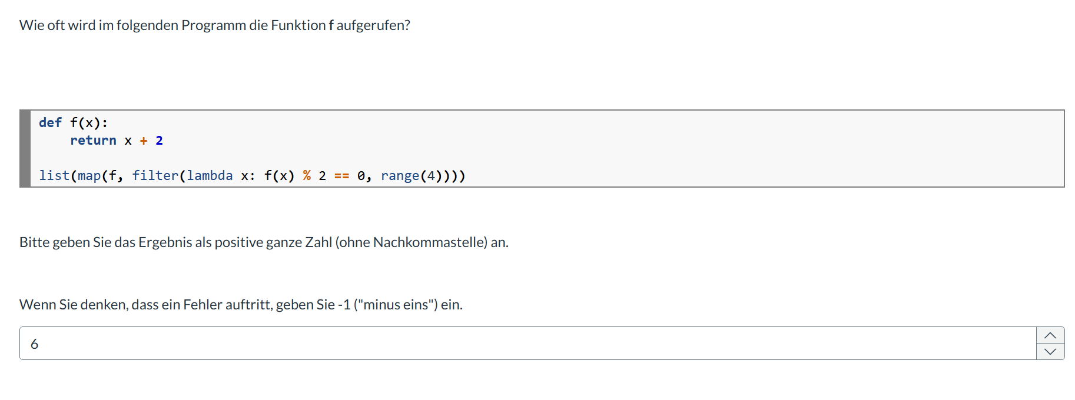
Question 1
Discussion Quiz 4

Slide 14
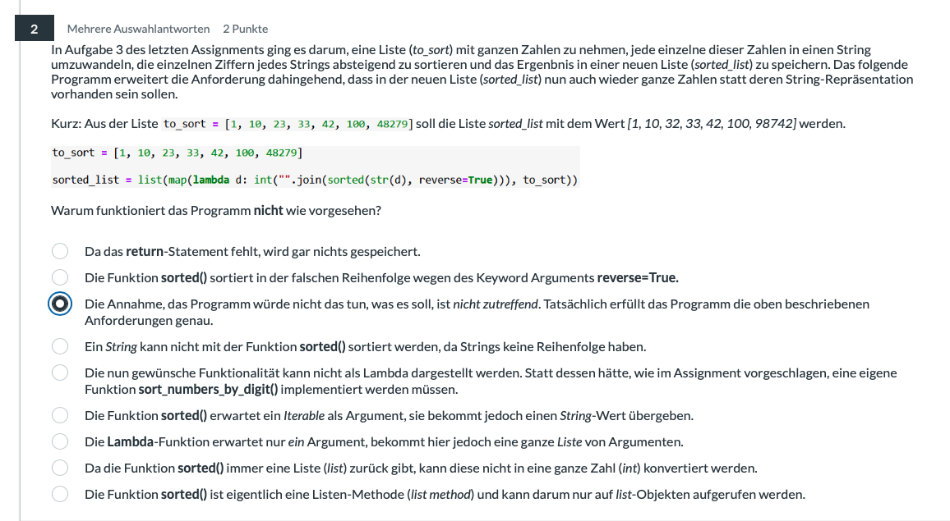
Question 2
Discussion Quiz 4

Slide 15
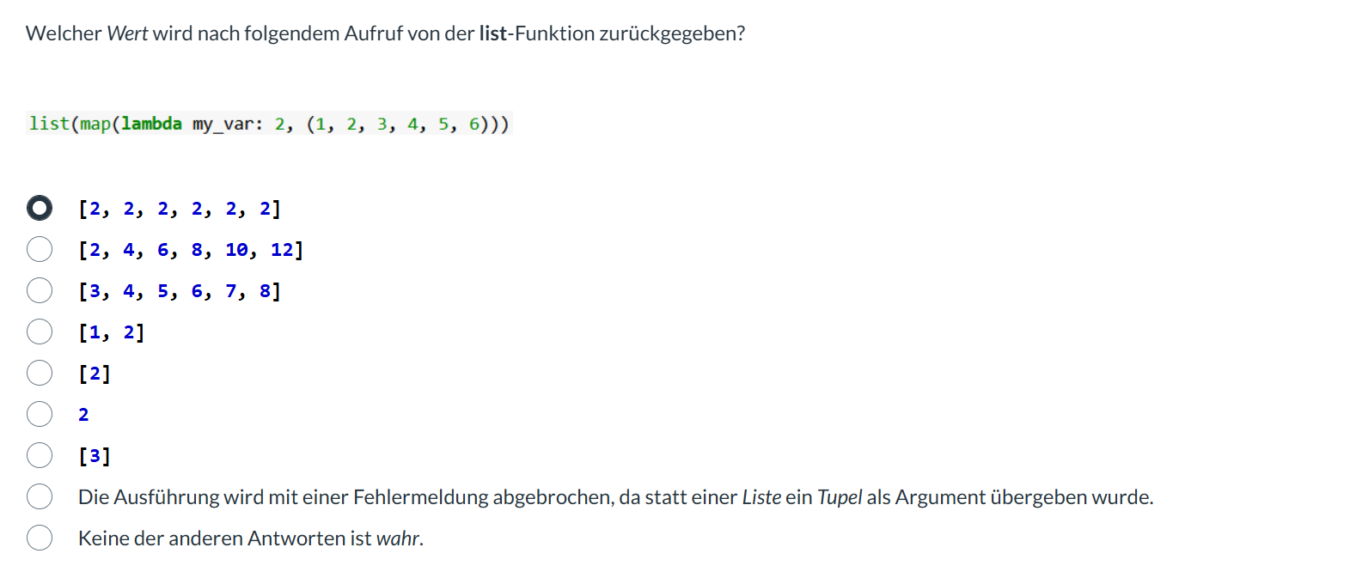
Question 3
Discussion Quiz 4

Slide 16
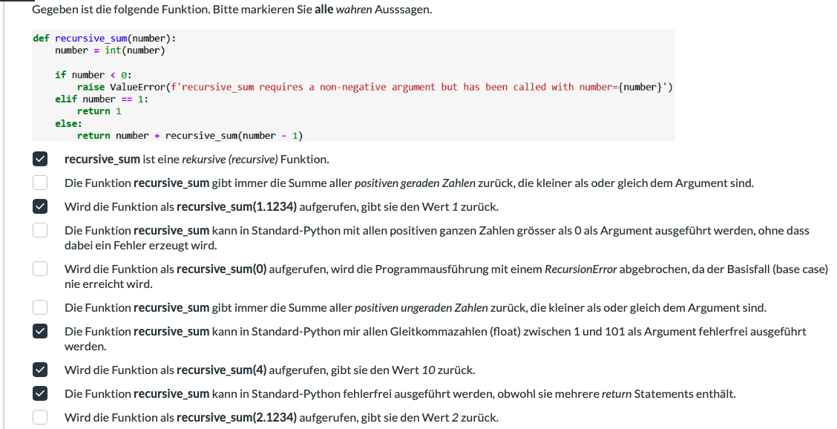
Question 4
Discussion Quiz 4

Slide 17
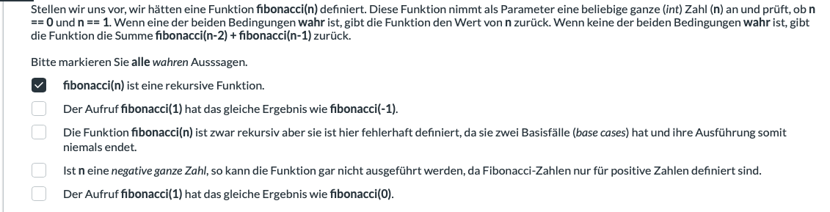
Question 5
Discussion Quiz 4

Slide 18
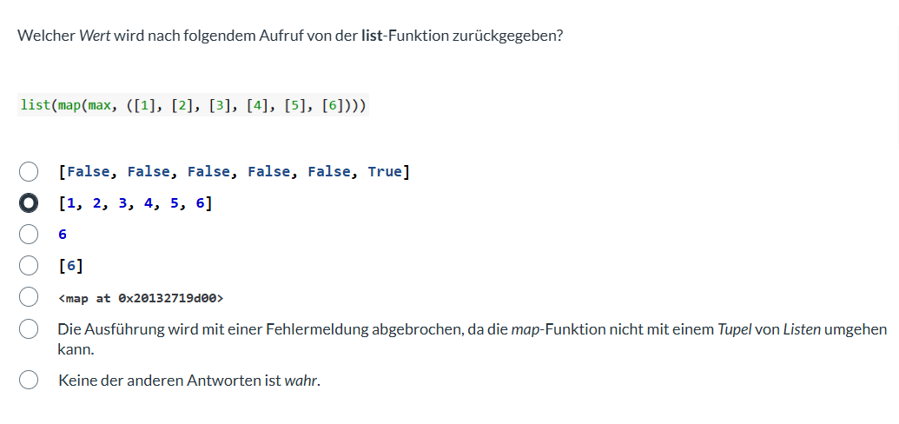
Question 6
Discussion Quiz 4

Slide 19
Brief summary of skills necessary to solve assignment 5

Slide 20
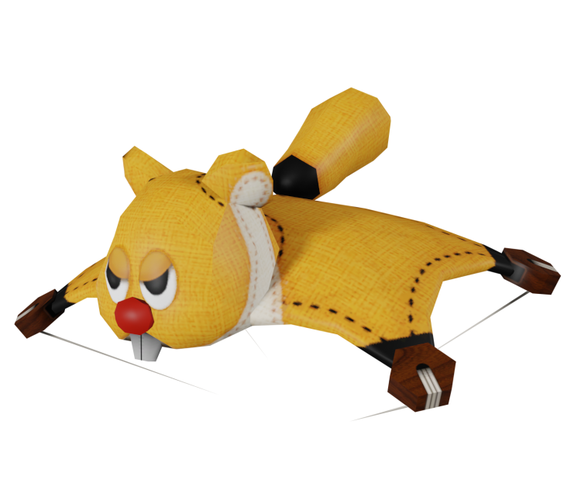
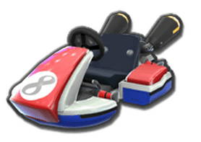
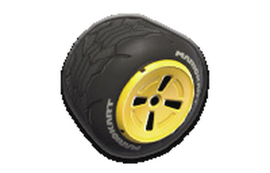
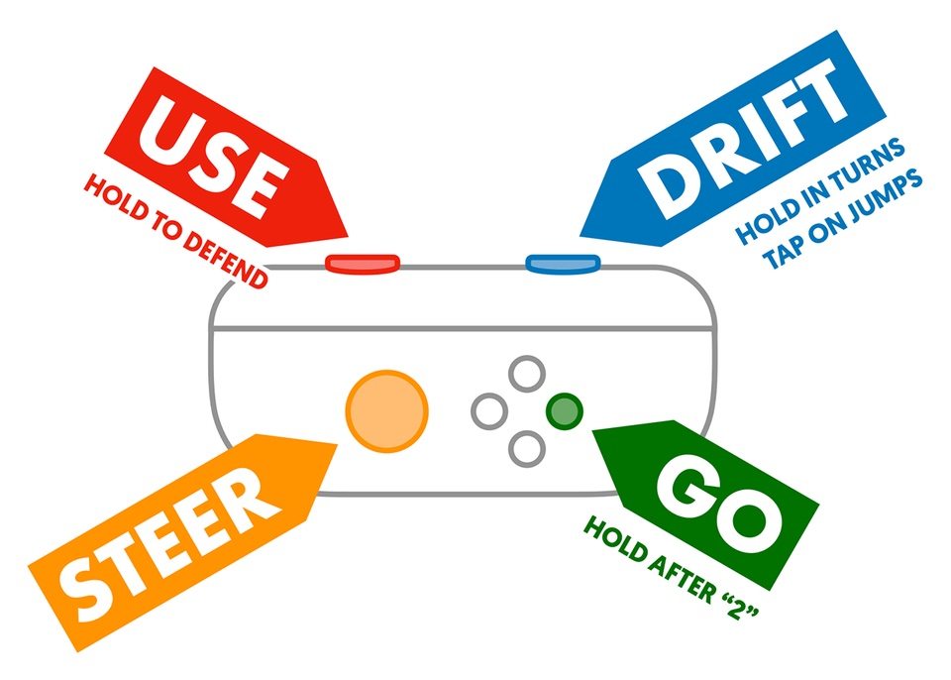
Getting the right intuition about Object Oriented Programming
Brief summary of skills necessary to solve assignment 5
Imagine you want to re-create Mario Kart 8. You start with creating the kart options. For this, you will need:
The 3d models of the kart parts, consisting of:
Main bodies of different karts
Different wheelsets
Different wings
The functionality of karts, consisting of:
Acceleration/deceleration of the kart’s body
Left and right turning
Drifting animation
Wheel spin
Turning of front wheels
Image sources:
https://mariokart.fandom.com/wiki/Standard_(wheel)
https://wovenlearning.org/lessons/3-introduction-to-mario-kart/
https://www.models-resource.com/wii_u/mariokart8/model/47932/
https://www.reddit.com/r/mariokart/comments/13coepp/whats_the_best_standard_kart_from_the_mk_series/

Slide 21
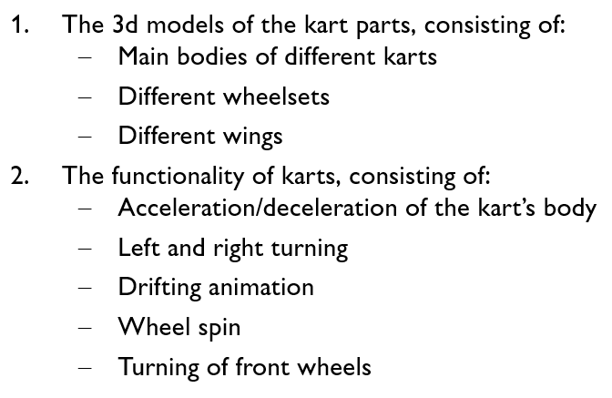
Getting the right intuition about Object Oriented Programming
Brief summary of skills necessary to solve assignment 5
Class dictates fundamentals of objects:
In terms of Object Oriented Programming, each kart a player has compiled becomes a specific ‘object’. Notice that you let players choose parts (body, wheels, wing) and then a kart is created based on an underlying template. That template (dictating that a kart has the required parts and functionality) is a ‘class’.
A class defines what characteristics objects of that class may have. We call these characteristics ‘attributes’.
It also dictates the functionality that is built into its objects. We call the functions that are defined in the class definition ‘methods.’
(to call a method, we use this syntax:
object_var_name.method_name(parameters) → my_cart.accelerate(5))
Attributes
Methods
Objects are specific instantiations of a class:

Slide 22
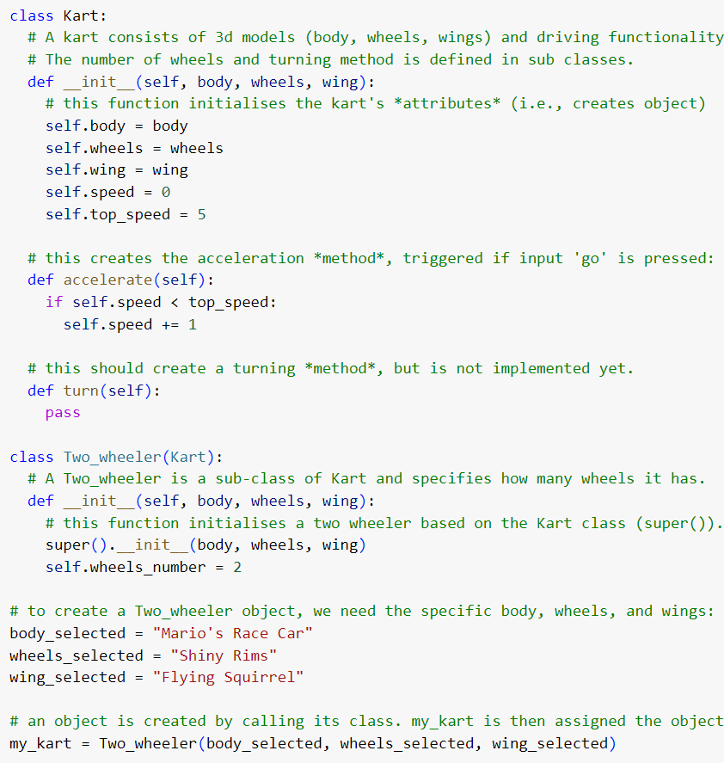
Getting the right intuition about Object Oriented Programming
Brief summary of skills necessary to solve assignment 5
The benefit us using classes based on which we create objects is that we can re-use the template (class) to create many objects, without having to re-write them.
We can also create a ‘sub class’ that re-uses the attributes and methods of the class but adds other attributes and methods that only apply for objects of that specific sub class (e.g., the number of wheels might not be defined in the base class (aka ‘super class’), but in a sub class (e.g., sub class ‘Two_wheeler’).
The sub class inherits all attributes and methods from the super class (‘inheritance’), but it can also overwrite them, by using the same attribute/method names (‘polymorphism’).
initialisation method
attributes
Class definition
method (note the ‘self’ reference, otherwise it’s like a function definition)
Sub class
definition
Object will inherit attribute definition from super class.
We can extend (here) or even overwrite (polymorphism) attributes and methods for this sub-class only
Instantiation of an object

Slide 23
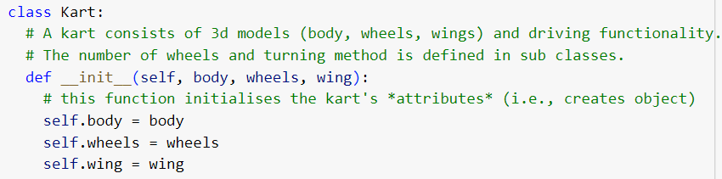
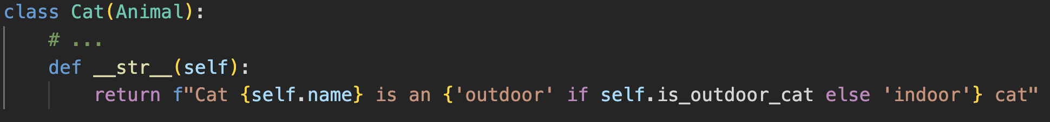
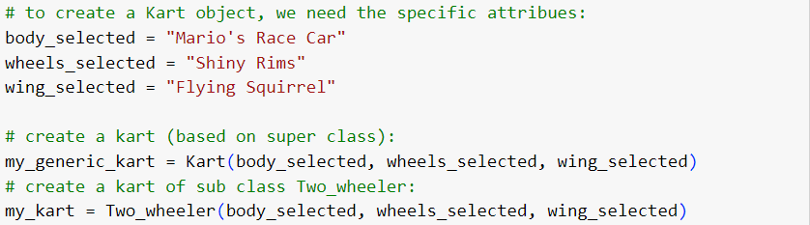
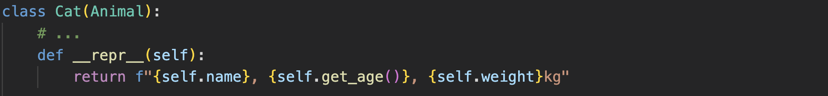
Special Methods
Brief summary of skills necessary to solve assignment 5
__init__
__str__ / __repr__
__init__ is a special method that is called when creating an object of the respective class. We need to define it in the class definition:
The __str__ method should return a human readable string that lets you know more about the object. __str__ is automatically called, if you try to print() an object, or if you use my_object.__str__() or str(my_object).
> “H”
> “!”
> “!”
> “H”
> “Hello”
To trigger the __init__ method (aka constructor method) we simply call the (sub) class like a function:
> “World!”
The __repr__ method returns an unambiguous representation of an object—usually for debugging. It may return the information needed to re-create the object, for example. It is called by using repr() on an object. (i.e., my_object.__repr__() or repr(my_object)

Slide 24
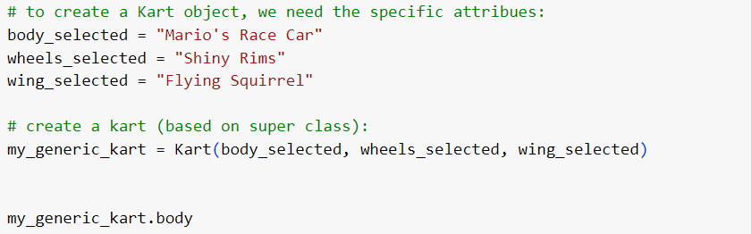

Accessing attributes and methods of an object
Brief summary of skills necessary to solve assignment 5
Accessing attribute values
Calling methods
The syntax to access an object’s attribute values is:
object_name.attribute_name
Assuming we used the class definition above and have created an object as follows:
… we can thus access the body attribute like this:
(which returns “Mario’s Race Car”)
The syntax to call a method is:
object_name.method_name(attributes)
Using the class definition above, we might wish to use accelerate on our object my_generic_kart. We would thus use this code:
Note that there is no need to add ‘self’ as an attribute, because the self-reference is already operationalised with the reflexive ‘ . ’ that attaches the method to the object.
See also next pages (getter & setter)

Slide 25
Excursus: Getter, Setter & @ Decorator

Slide 26
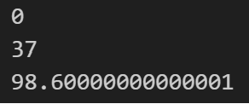
Access attributes directly
Code
class Celsius:
def __init__(self, temperature=0):
self.temperature = temperature
def to_fahrenheit(self):
return (self.temperature * 1.8) + 32
# Create a new object
human = Celsius()
print(human.temperature)
# Set the temperature
human.temperature = 37
# Get the temperature attribute
print(human.temperature)
# Get the to_fahrenheit method
print(human.to_fahrenheit())
Idea
If we can access attribute values by using object_name.attribute_name, we might think that changing its value by using this syntax is also possible.
… and it is.
However, since we are using a class and thus, a template of sorts, we might not want to change attribute values freely. Maybe we want to check whether the new value is as expected (e.g. formatted as a date, or within a reasonable range). Or we might not want to ever change it (like a student ID number).
> “H”
> “!”
> “!”
> “H”
> “Hello”
> “World!”

Slide 27


Attribute Protection by Convention
Code
class Celsius_Protected:
def __init__(self, temperature=0):
self._temperature = temperature
human = Celsius_Protected()
print(human._temperature)
human._temperature = 37
print(human._temperature)
########################################################
class Celsius_Private:
def __init__(self, temperature=0):
self.__temperature = temperature
human = Celsius_Private() print(human._Celsius_Private__temperature)
human._Celsius_Private__temperature = 37
print(human._Celsius_Private__temperature)
# print(human.__temperature) # does not work anymore
human.__temperature = 80
print(human.__temperature)
Intuitive Solution
Remember how we do not use variable names that start with special characters? Well… We can use this idea and precede the attribute value with an underscore (see ‘Celsius_Protected’). This will not affect the accessing and overwriting per se but avoids mistakes.
More secure is to use two underscores. In this case, we can no longer access or change the variable directly. It will think that you want to create a new variable. We can access it with this syntax still: _Classname__attribute_name
> “H”
> “!”
> “!”
> “H”
> “Hello”
> “World!”

Slide 28
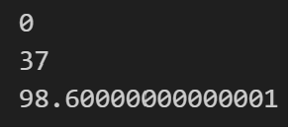
Getters & Setters
Code
class Celsius:
def __init__(self, temperature=0):
self.set_temperature(temperature)
def to_fahrenheit(self):
return (self.get_temperature() * 1.8) + 32
def get_temperature(self):
return self._temperature
def set_temperature(self, value):
if value < -273.15:
raise ValueError(“T < -273.15 not possible")
self._temperature = value
human = Celsius()
print(human.get_temperature())
human.set_temperature(37) # try constraint with -300
print(human.get_temperature()) print(human.to_fahrenheit())
Idea: Using Methods
Instead of accessing attributes, we can also use methods to get and set attribute values. This allows us to intervene, in case this may be necessary. E.g.: not letting users get a password, or not letting them set an unreasonable value.
To implement this, we could just define methods, see example code.
(note: This does not protect from overwriting attributes directly as seen on the last two slides)
> “H”
> “!”
> “!”
> “H”
> “Hello”
> “World!”

Slide 29

Using @ Decorator
Code
class Celsius:
def __init__(self, temperature=0):
self.temperature = temperature
def to_fahrenheit(self):
return (self.temperature * 1.8) + 32
@property
def temperature(self):
return self._temperature
@temperature.setter
def temperature(self, value):
if value < -273.15:
raise ValueError(“T < -273.15 not possible")
self._temperature = value
human = Celsius(37)
print(human.temperature) # getter
human.temperature = 38 # setter
print(human.temperature) # setter
print(human.to_fahrenheit())
OOP Solution: Getters & Setters
In Python, there is an @ decorator we can use. It comes in two flavours and we write it right above a method definition:
Get a value (getter): To get a value, we use the @property decorator.
Set a value (setter): we use the @attribute_name.setter decorator.
(see code example)
Getting and setting attribute values uses the syntax object_name.attribute_name. With our decorators, Python will see that this call (e.g. human.temperature) can be various things and correctly chooses the getter or setter method.
> “H”
> “!”
> “!”
> “H”
> “Hello”
> “World!”

Slide 30
Now you have everything you need to start with assignment 5

Slide 31
<Your name>
<Function>
first.last@<student>.unisg.ch

